Slide 1
Power System Fault Detection and Classification
CAPSTONE PROJECT
Presented By:
Vineet Verma
GL Bajaj Institute Of Technology and Management
Department - Information Technology (IT)

Slide 2
OUTLINE
Problem Statement (Should not include solution)
Proposed System/Solution
System Development Approach (Technology Used)
Algorithm & Deployment
Result (Output Image)
Conclusion
Future Scope
References

Slide 3
Problem Statement
Design a machine learning model to detect and classify different types of faults in a power distribution system. Using electrical measurement data (e.g., voltage and current phasors), the model should be able to distinguish between normal operating conditions and various fault conditions (such as line-to-ground, line-to-line, or three-phase faults). The objective is to enable rapid and accurate fault identification, which is crucial for maintaining power grid stability and reliability.

Slide 4
Proposed Solution
Data Acquisition & Understanding Utilize the Kaggle dataset containing electrical parameters (Voltage, Current, etc.) under normal and various fault conditions.
Data Preprocessing
Handle missing or inconsistent values
Normalize/standardize voltage & current readings
Encode fault types for classification
Perform feature selection to focus on key electrical signatures
Model Design
Implement supervised machine learning algorithms (e.g., Random Forest, SVM, or Neural Networks)
Train models to classify:
Line-to-Ground Fault
Line-to-Line Fault
Three-Phase Fault
No Fault (Normal)
Cloud Integration – IBM Cloud Lite
Use IBM Watson Studio for model development and training
Deploy trained model as a REST API using IBM Cloud Functions or IBM Cloud Foundry
Monitor performance and enable online predictions
Evaluation & Optimization
Assess using accuracy, precision, recall, and F1-score
Use confusion matrix for detailed fault classification analysis
Fine-tune hyperparameters for optimal results
Outcome A reliable ML system that can automatically detect and classify faults, enabling faster fault response and power grid stability.

Slide 5
System Approach
The "System Approach" section outlines the overall strategy and methodology for developing and implementing the Power System Fault Detection and Classification model. Here's a suggested structure for this section:
System requirements – Windows 10 OS, 8GB RAM, Python 3.x
Resources required on IBM Cloud platform to run AutoAI experiment – Watson Studio, Cloud Object Storage, Watson Machine Learning

Slide 6
Algorithm & Deployment
Step 1 – Allocate Cloud Object Storage and Watson Studio in IBM Cloud
Step 2 – Create a new project and enter project name, then click on create
Step 3 – Associate Watson Machine Learning service
Step 4 – Select AutoAI to automatically build models
Step 5 – Enter a name and create the AutoAI experiment
Step 6 – Upload the power system faults dataset from Kaggle to IBM Cloud and select it in AutoAI
Step 7 – Select the target column (Fault Type) to classify fault types based on voltage and current readings
Step 8 – Click on "Run Experiment“
Step 9 – Algorithm Selection: AutoAI will automate model selection, hyperparameter tuning, and recommend the best classification model for power system faults
Step 10 – Save the model with the highest accuracy
Step 11 – Click "Promote to Deployment Space" to deploy the model
Step 12 – Evaluation and testing using new voltage/current data for fault prediction

Slide 7
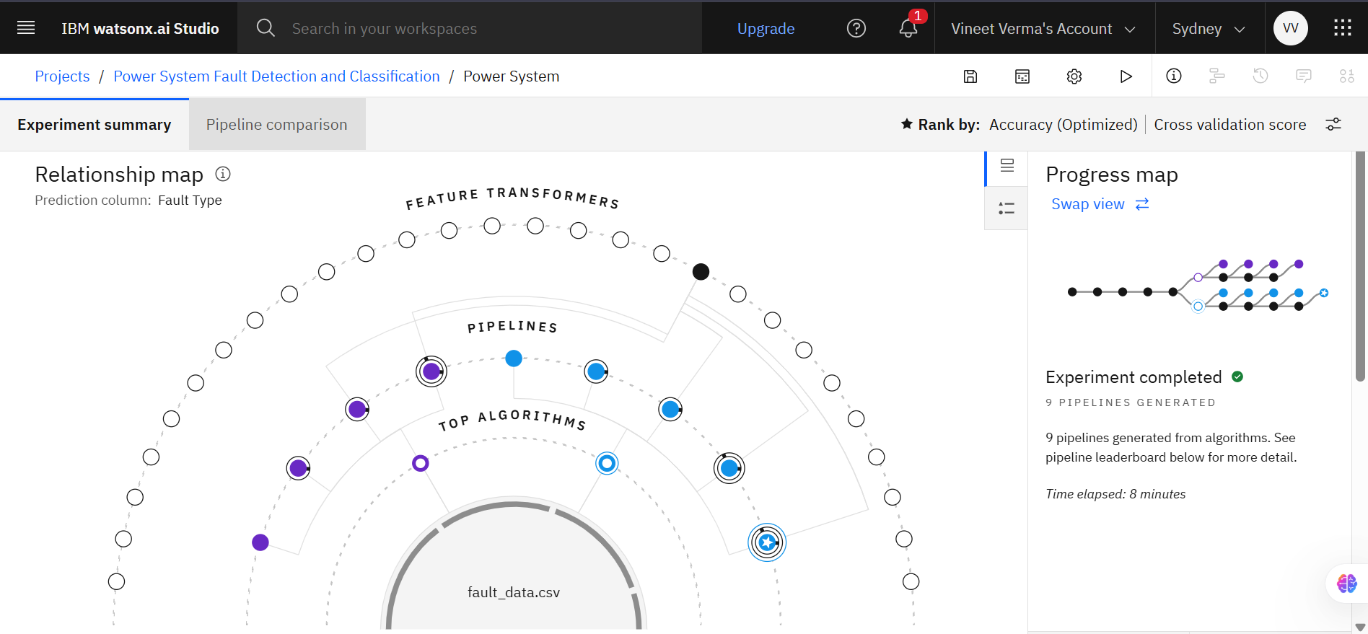
Result

Slide 8
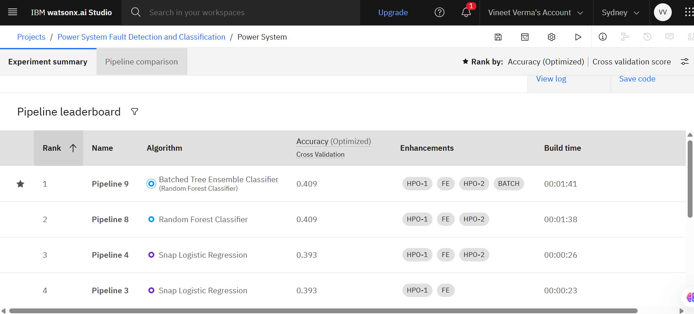

Slide 9
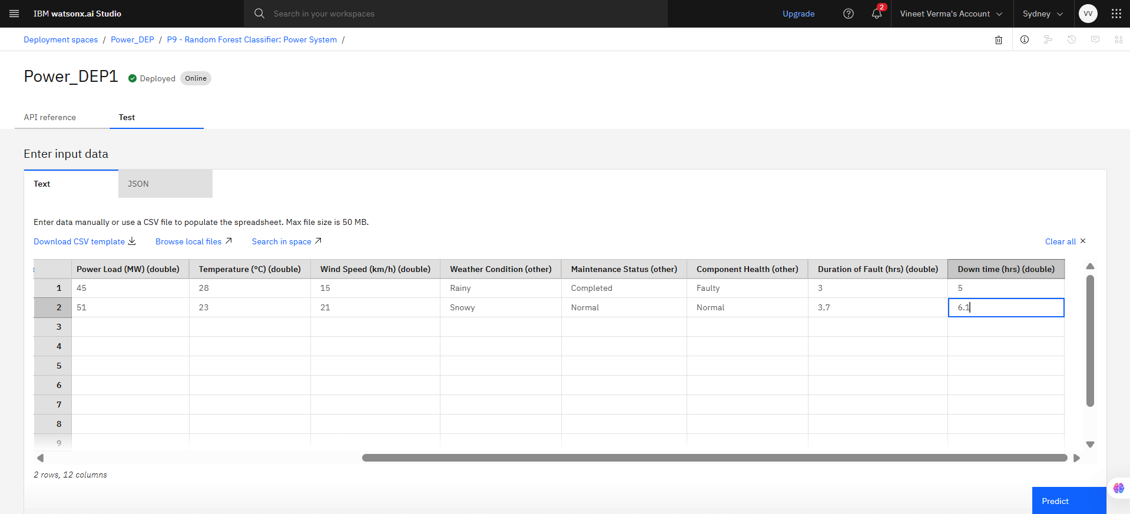
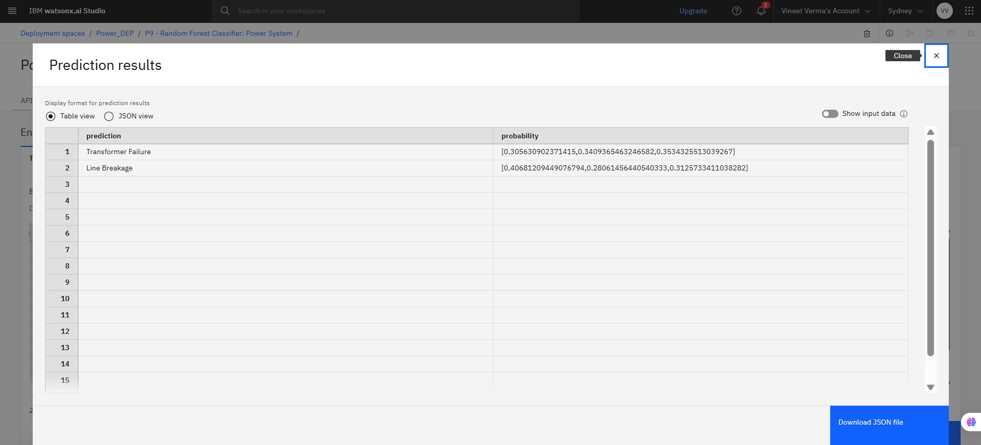

Slide 10
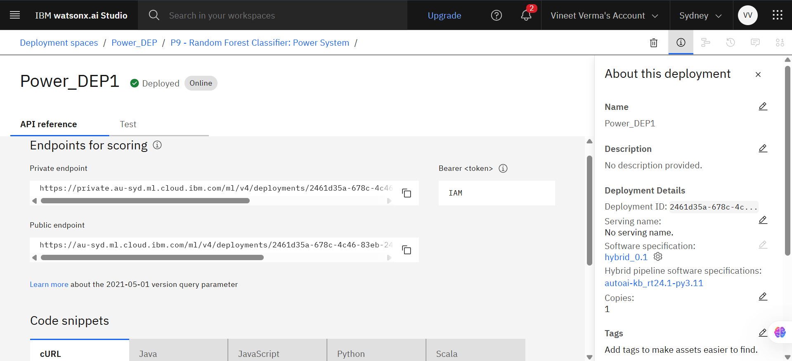

Slide 11
Conclusion
The system successfully detects and classifies different types of power system faults using machine learning techniques, ensuring rapid and accurate fault identification.
This approach enables electrical utilities to respond faster to faults, reduce downtime, and maintain grid stability and reliability.
The results highlight the significance of integrating machine learning into power systems for real-time monitoring and intelligent fault management. By leveraging such data-driven solutions, power distribution networks can become more efficient, resilient, and future-ready.

Slide 12
Future scope
Real-Time Integration: Connect with SCADA/smart meters for live fault detection.
Fault Location Estimation: Extend model to pinpoint fault locations on the grid.
Edge Deployment: Deploy lightweight models on substations for on-site analysis.
Renewable Support: Adapt system for dynamic behavior from solar and wind sources.
Scalability: Scale to large power grids using cloud-native and distributed systems.
Automated Alerts: Use IBM Cloud to trigger real-time alerts and maintenance actions.

Slide 13
References
ChatGPT
IBM cloud platform
Research Paper – “Power System Fault Detection and Classification Using Machine Learning” – Link to paper
Project Link –
https://dataplatform.cloud.ibm.com/projects/846904b4-ea60-4dee-b506-01ca07e1daa7?context=cpdaas

Slide 14
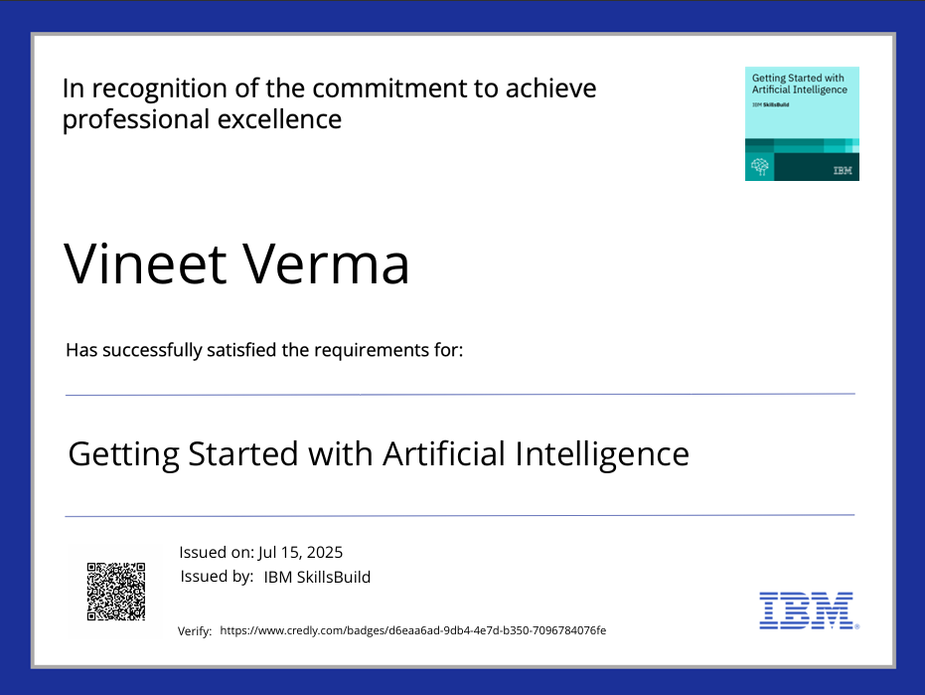
IBM Certifications

Slide 15
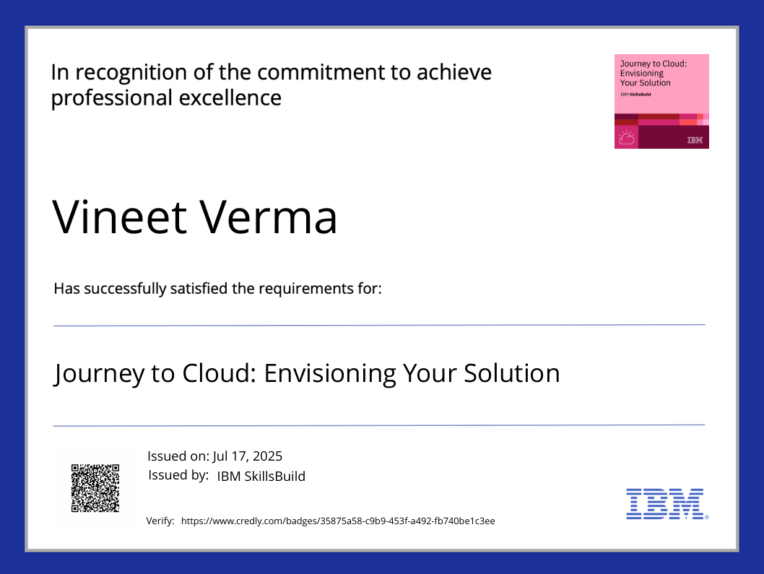
IBM Certifications

Slide 16
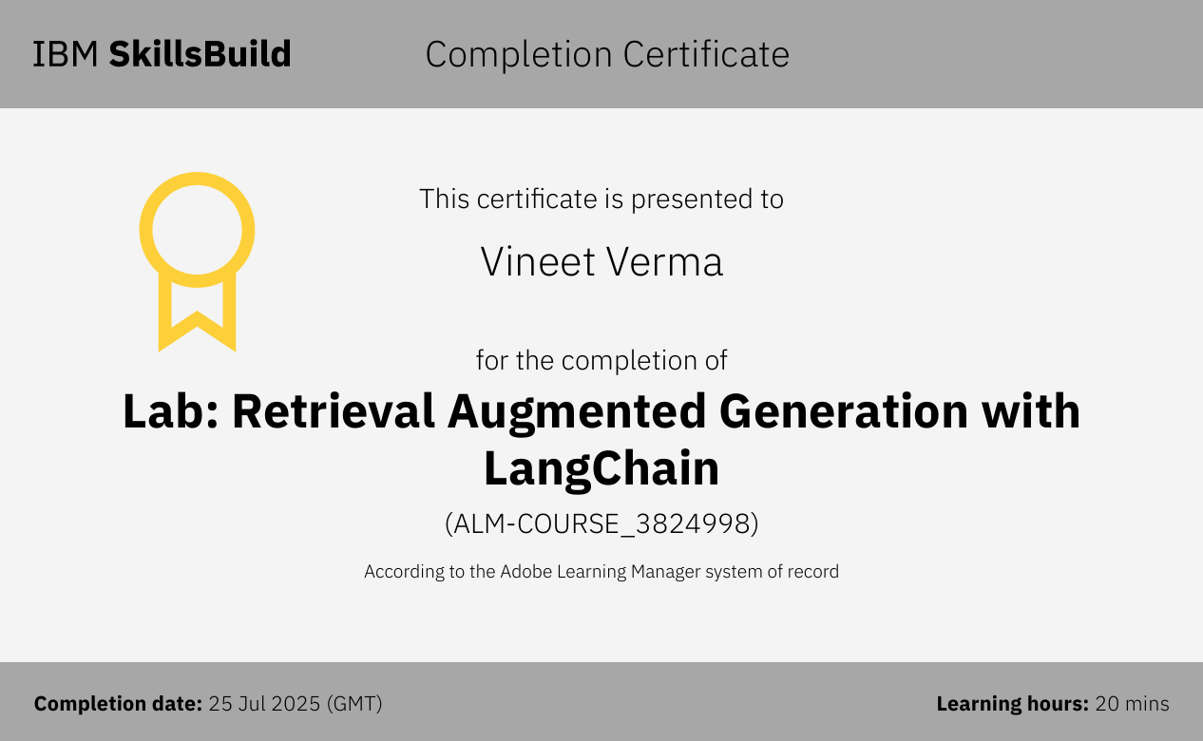
IBM Certifications

Slide 17
THANK YOU

